Slide 1
Creating C.U.T.E. Domain-Specific DID Grammars (DSDG) and Parsers https://github.com/mwherman2000/did-uri-spec
v0.3
Michael Herman
Independent Blockchain Architect
mwherman@parallelspace.net

Slide 2
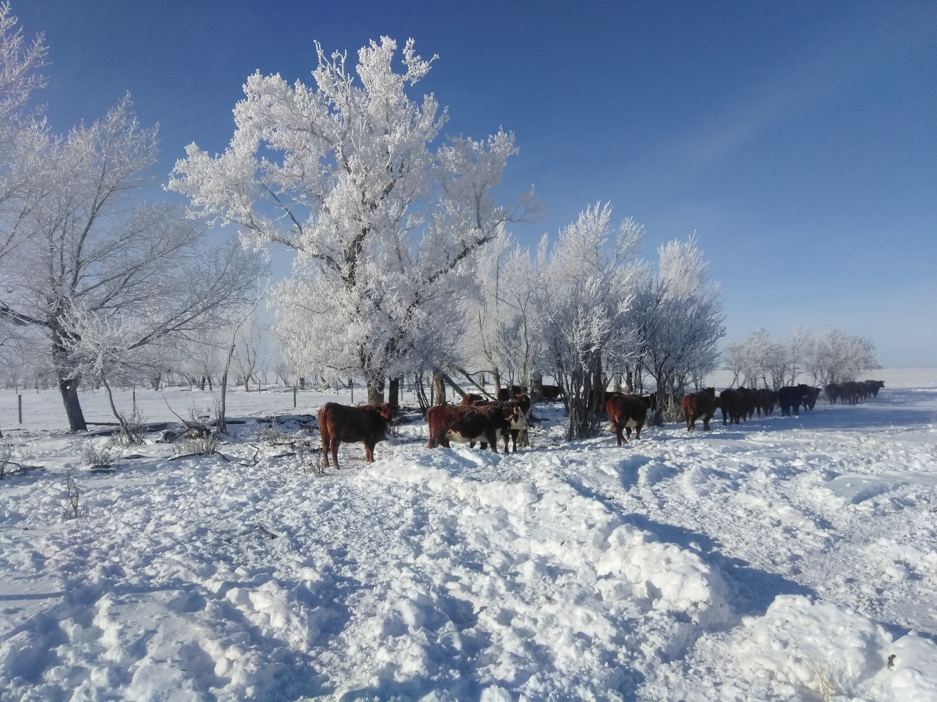
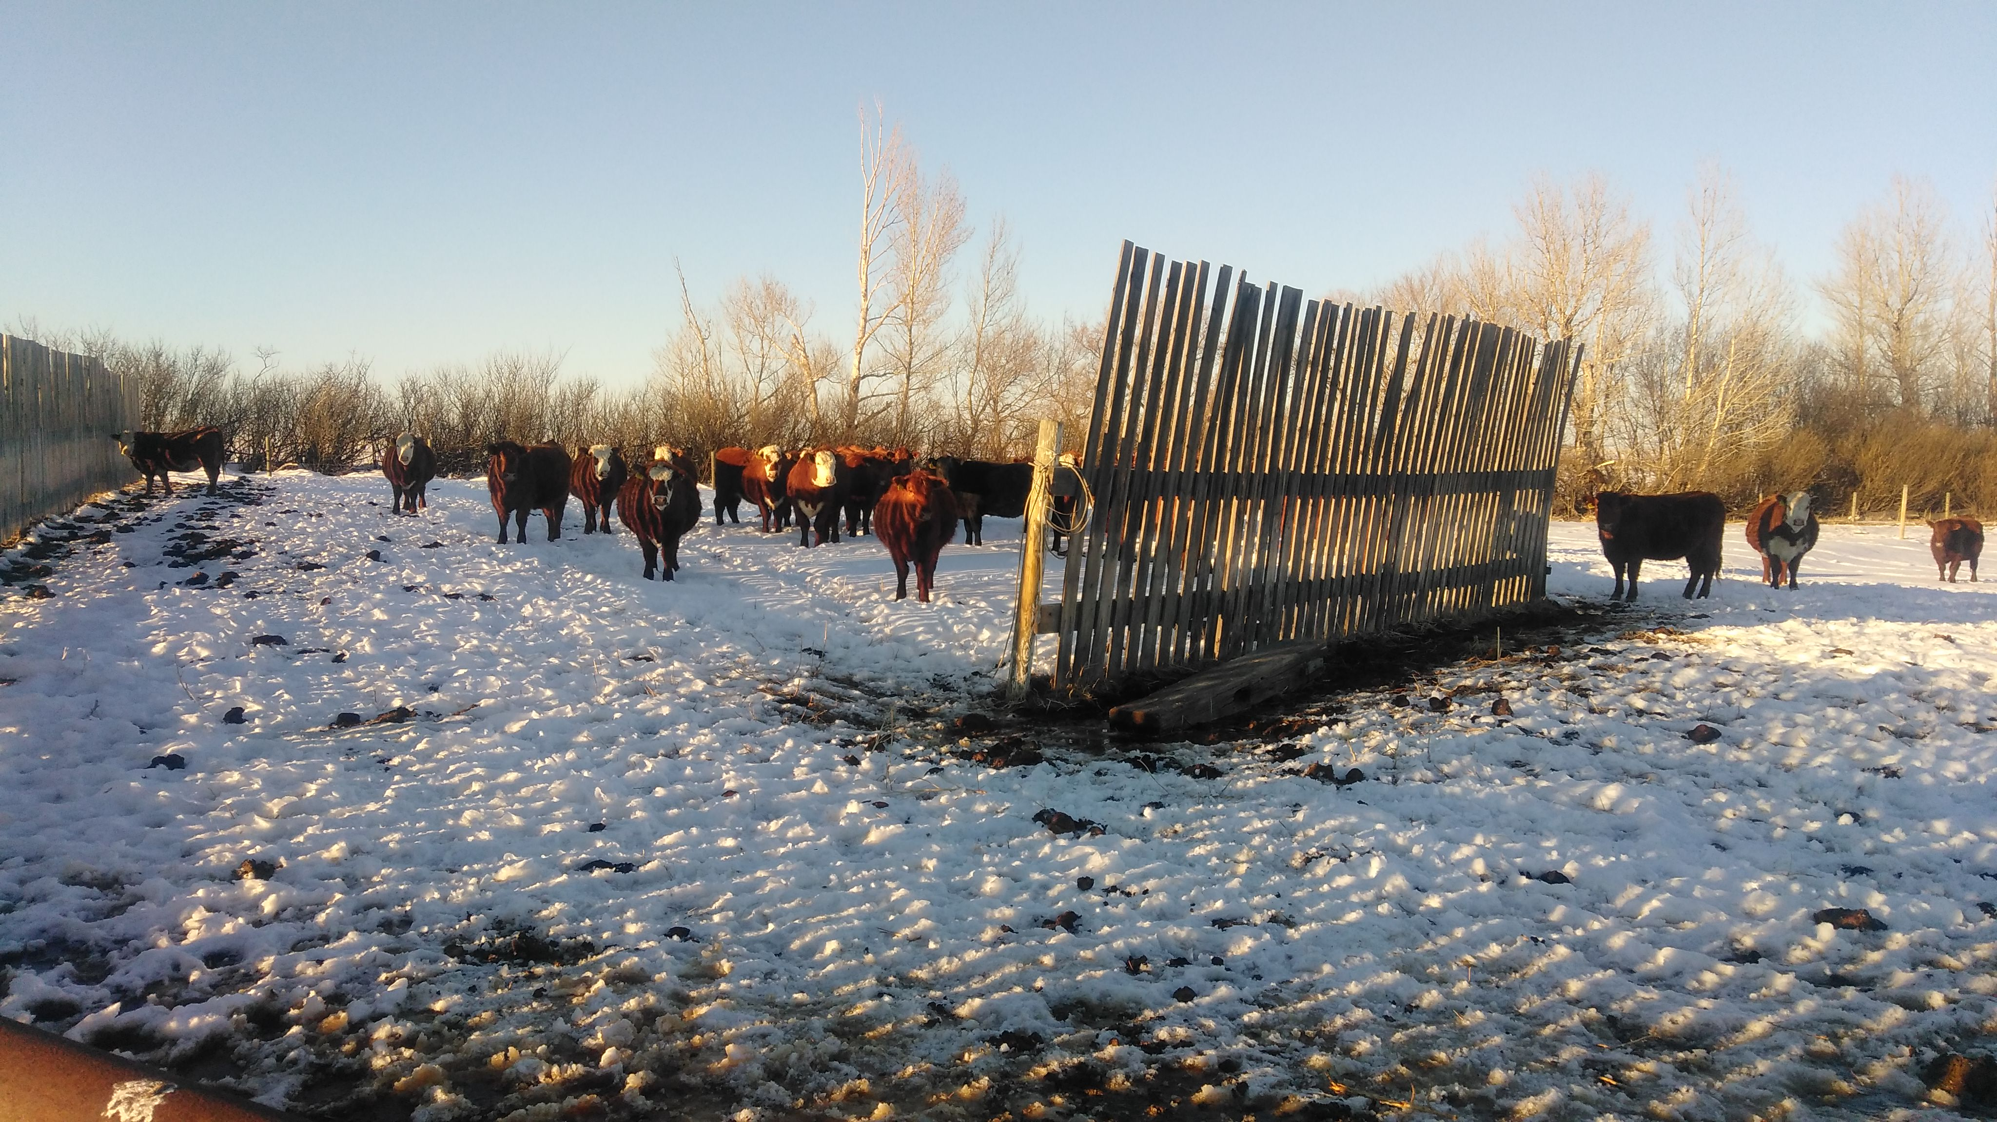
Michael Herman Independent Blockchain Architect Alberta, CANADA

Slide 3
Purpose and Audience
Purpose
The purpose of this presentation is to:
Announce the reference implementation of the did-uri-spec grammar
Demonstrate how to create a C.U.T.E. Domain-Specific DID Grammar (and parser).
Audience
The primary audience for this presentation is implementors and maintainers of parser software that is compliant with the did-uri-spec including but not limited to:
W3C Decentralized Identifier specification
DID Resolvers and DID Resolution
Agent-to-Agent (A2) Communications services in the Hyperledger Indy Agent framework

Slide 4

What is a C.U.T.E. DID Grammar?
RFC 3986
Compliant
A C.U.T.E. DID Grammar is a did-uri-spec compliant grammar that is:
Concise
Understandable
Technically Elegant
A C.U.T.E. DID Grammar is a did-uri-spec grammar that is easy to extend to target an infinite number of application areas by being able to easily create Domain-Specific DID Grammars (DSDGs) and automatically generate compliant parsers (Java, C++, and C#).
A DSDG limits the number of transformer-options that are required/available for a specific application domain.
The generic/baseline C.U.T.E. DID Grammar as well as any DSDGs derived from the C.U.T.E. DID Grammar are:
Verifiably did-uri-spec compliant grammars, and, in turn,
RFC 3986 compliant grammars

Slide 5
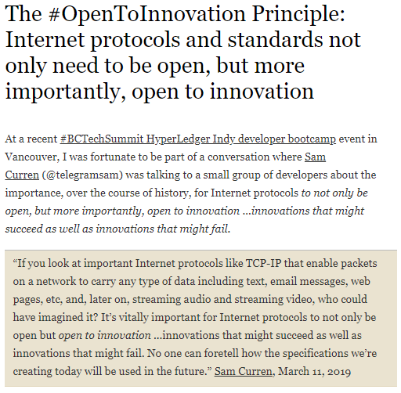
#1.1

Slide 6
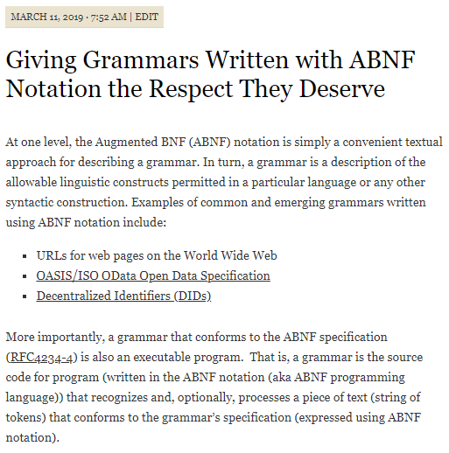
#1.2 (1/3)

Slide 7
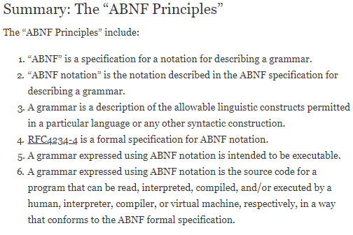
#1.2 (2/3)

Slide 8
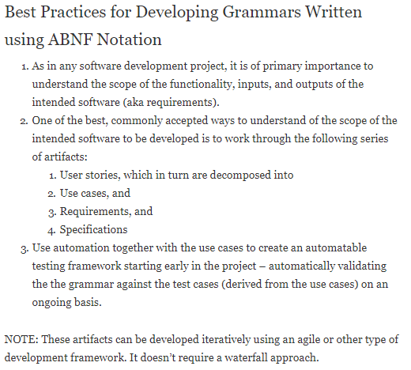
#1.2 (3/3)

Slide 9
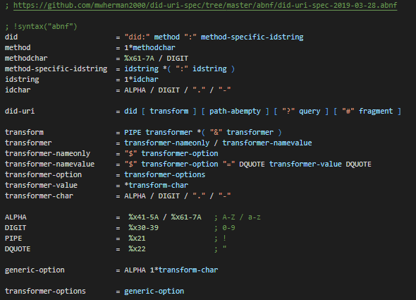
C.U.T.E. DID Grammar (generic did-uri-spec Grammar)

Slide 10
High-level did-uri User Scenarios (Slide 45)
# | did-uri Syntax Patterns | Type of Document Returned
1 | <did> | DID Document
2 | <did>!$selectId="exam_src" | DID Document Fragment
3 | <did>!$serviceId="exam_src" | Remapped Service Endpoint URI/URL
4 | <did>!$contentId="pqrs" | DID Doc Content Fragment
5* | <did>!$attachmentId="abcd" | A2A Message Attachment Fragment
6 | "query": "<did>!$filter='*'" | Array of All Service Agent Feature/Protocol Descriptions
7 | "query": "<did>!$filter='spec/tictactoe/1.*'" | Array of Filtered Service Agent Feature/Protocol Descriptions
8 | <didmethod>!$supportedCapabilities | Array of DID Method Capabilities
9a | did:!$documents / did:xyz:!$documents | Array of DID Documents
9b | did:xyz:!$documents&$top=10&$skip=100 | Batch of DID Documents

Slide 11
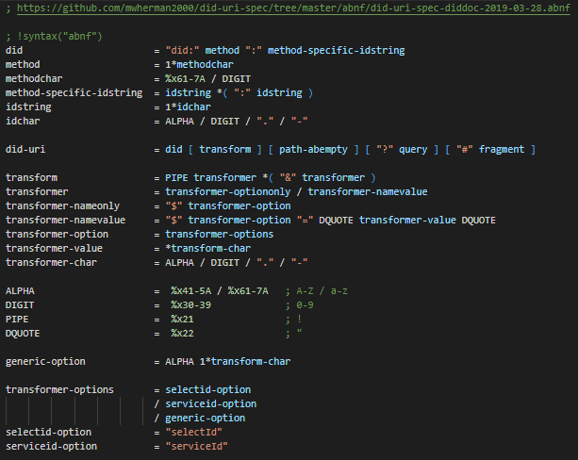
C.U.T.E. DID Grammar: Domain-Specific Grammar
DIDDoc

Slide 12
High-level did-uri User Scenarios (Slide 45)
# | did-uri Syntax Patterns | Type of Document Returned
1 | <did> | DID Document
2 | <did>!$selectId="exam_src" | DID Document Fragment
3 | <did>!$serviceId="exam_src" | Remapped Service Endpoint URI/URL
4 | <did>!$contentId="pqrs" | DID Doc Content Fragment
5* | <did>!$attachmentId="abcd" | A2A Message Attachment Fragment
6 | "query": "<did>!$filter='*'" | Array of All Service Agent Feature/Protocol Descriptions
7 | "query": "<did>!$filter='spec/tictactoe/1.*'" | Array of Filtered Service Agent Feature/Protocol Descriptions
8 | <didmethod>!$supportedCapabilities | Array of DID Method Capabilities
9a | did:!$documents / did:xyz:!$documents | Array of DID Documents
9b | did:xyz:!$documents&$top=10&$skip=100 | Batch of DID Documents

Slide 13
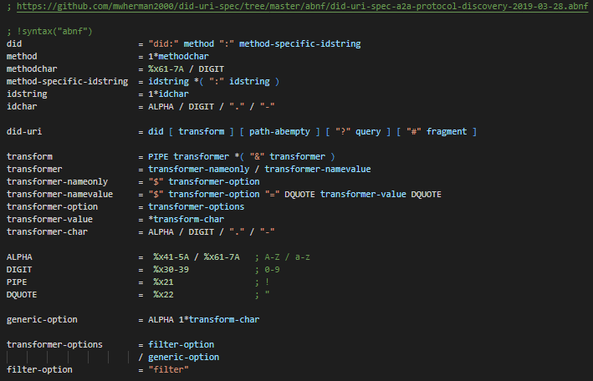
C.U.T.E. DID Grammar: Domain-Specific Grammar
Indy
A2A
Protocol
Discovery

Slide 14
High-level did-uri User Scenarios (Slide 46)
# | did-uri Syntax Patterns | Type of Document Returned
10 | <did>!?$exists | True or False
11 | <did>!?$exists="bops" | True or False
12 | <did>!$type="diddoc" (default type – UC #1) | DID Document
13 | <did>!$type="schema" | Schema Document
14 | <did>!$type="creddef" | Credential Definition Document
15 | <did>!$type="overlay.format" | Format Overlay Document
16 | <did>!$type="node" | VDR Node Document
17 | did:!$type="config.pool" | Pool Configuration Document
18 | did:!$type="perfmon.pool" | Pool Performance Monitoring Doc
19 | did:xyz:!$type="perfmon.didmethod" | DID Method Perf. Monitoring Doc

Slide 15
Grammar-Based Automated Parser Generation
aparse parser generator (http://www.parse2.com)
parse2 produces the aParse parser generator that reads Augmented BNF grammars and produces Java, C++ or C# classes that can build parse trees for valid instances of those grammars. aParse is free to download and use without any obligations or limitations.
Using an aParse generated parser, a Java, C++ or C# program can confirm whether a stream of characters represents a valid instance of a particular grammar, for example, a message passed between two programs that should comply with an agreed protocol. The parse tree of a compliant message can be used by the program to process the message content (see the examples for a number of working programs that employ aParse generated parsers).

Slide 16
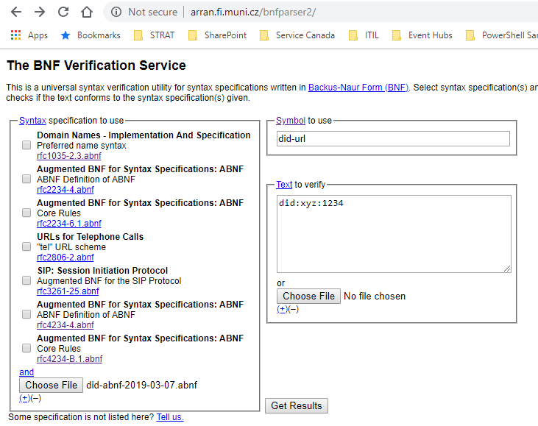
Grammar Testing / Validation
did-uri Grammar Validation Tool (Web)
The following web app is being used to validate the did-uri grammar against the lower-level use cases: The BNF Verification Service (http://arran.fi.muni.cz/bnfparser2/)

Slide 17
 Wrapping UP…
Michael Herman
Independent Blockchain Architect
mwherman@parallelspace.net
2019-03-29

Slide 18
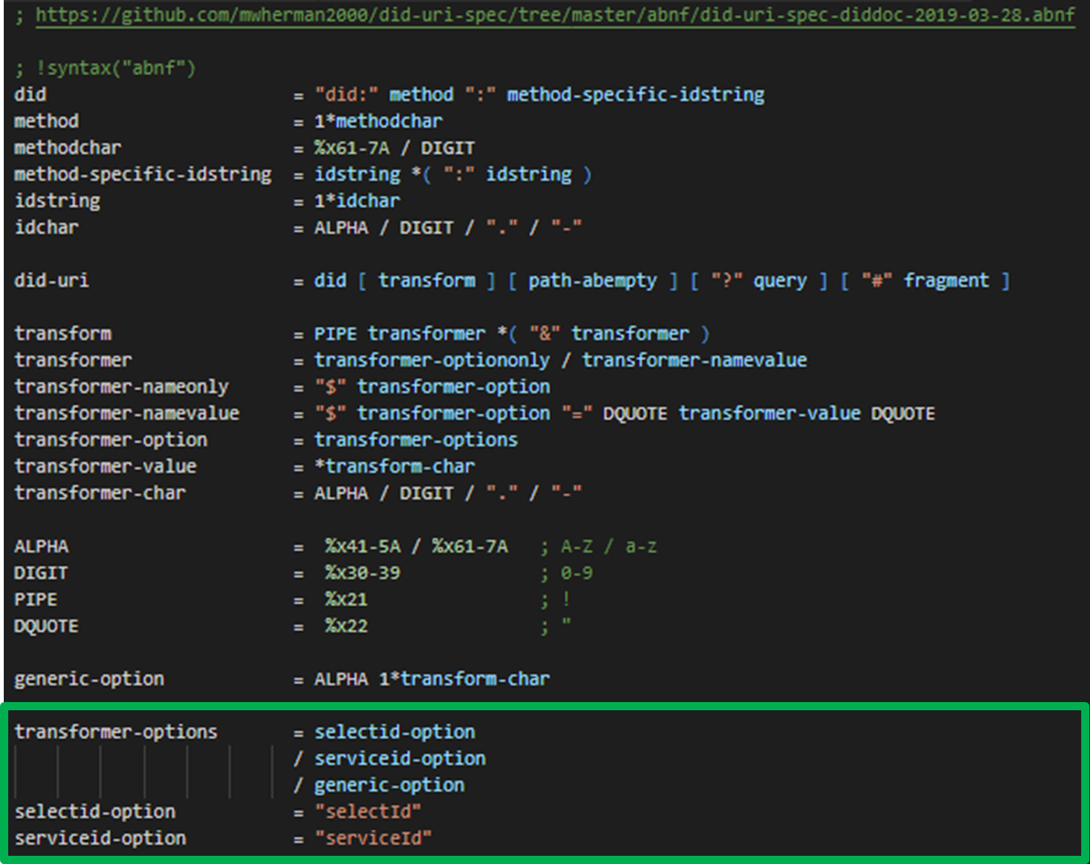
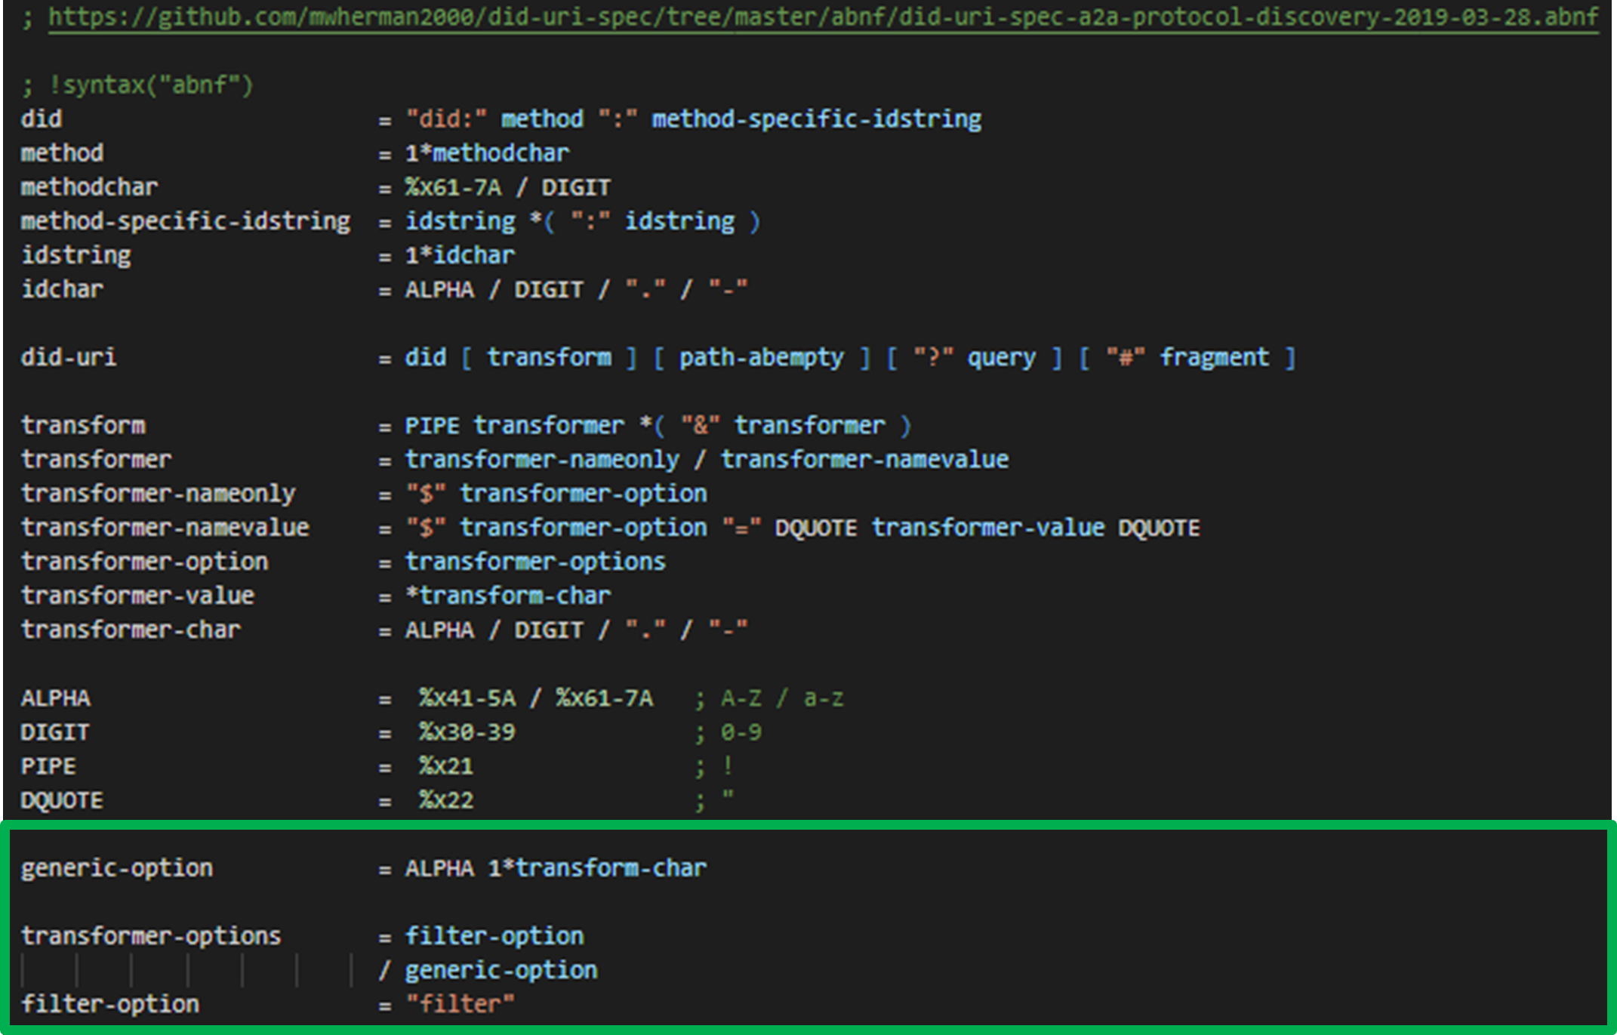
Derivation of Domain-Specific DID Grammars
did-uri-spec
Grammar
(Baseline)
DIDDoc
DSDG
Indy
A2A
Protocol
Discovery
DSDG

Slide 19
Next Steps
Continue to grow and validate the number of higher-level DID user scenarios and, more specifically, lower-level did-uri use cases with:
Diverse DID communities
Diverse DID higher-level DID user scenarios
More Indy HIPES
IPID, etc.
Build and test the did-uri grammar as well as all DSDGs
Using the lower-level did-uri use cases as a test cases
Continue to grow the outreach (awareness, knowledge and understanding) of the did-uri-spec specification amongst:
Diverse DID communities
Diverse DID higher-level DID user scenario specific scenarios
More Indy HIPES
IPID, etc.

Slide 20
 QUESTIONS?
Michael Herman
Independent Blockchain Architect
mwherman@parallelspace.net
2019-03-29

Slide 21
Creating C.U.T.E. Domain-Specific DID Grammars and Parsers
2019-03-29

